Slide 1
Final Project
Optimal Ship Routing and Personal Assignment for Naval Recruitment in Thailand
By
Lakshmi Prasanna Gundabolu

Slide 2
Description of Situation:
Thailand navy recruits are drafted four times a year. A draftee reports to one of the 34 centers in a home locality and then transported by bus to one of four navy branch bases. From there, recruits are transported to the main naval base by ship. All trips originate and terminate at the main base. Three classes of ships are available. Each branch base has limited capacity to accommodate all the draftees.

Slide 3
Research Question
How should the draftees be transferred by bus from drafting centers to the main branch base?
-Given the cost for each men travelling from drafting centers to naval bases.
-The number of men to be transported from each drafting center and the capacity of each naval bases.
- We have budget given for each naval base

Slide 4
Table for Problem 1
 | Destination Naval Bases
Origin (Drafting Centers) | D1 | D2 | D3 | D4 | Supply
O1 | 16 | 24 | 22 | 15 | 25
O2 | 24 | 20 | 21 | 18 | 30
O3 | 17 | 15 | 15 | 20 | 45
O4 | 22 | 14 | 24 | 21 | 80
O5 | 11 | 12 | 16 | 18 | 50
O6 | 12 | 24 | 20 | 21 | 75
O7 | 18 | 15 | 15 | 20 | 100
O8 | 17 | 17 | 15 | 21 | 125
O9 | 11 | 16 | 18 | 22 | 150
O10 | 19 | 15 | 14 | 13 | 65
O11 | 25 | 20 | 17 | 15 | 200
O12 | 12 | 13 | 14 | 15 | 48
O13 | 28 | 29 | 15 | 17 | 84
O14 | 9 | 12 | 15 | 11 | 175
O15 | 14 | 15 | 11 | 17 | 205
O16 | 20 | 14 | 22 | 11 | 50
O17 | 14 | 22 | 16 | 17 | 60
O18 | 22 | 17 | 15 | 20 | 70
O19 | 25 | 17 | 16 | 15 | 80
O20 | 15 | 17 | 20 | 20 | 185
O21 | 10 | 20 | 22 | 18 | 40
O22 | 11 | 12 | 18 | 13 | 30
O23 | 11 | 19 | 25 | 16 | 20
O24 | 16 | 29 | 12 | 17 | 20
O25 | 15 | 24 | 18 | 12 | 20
O26 | 20 | 12 | 21 | 22 | 132
O27 | 16 | 19 | 11 | 21 | 88
O28 | 15 | 29 | 12 | 12 | 135
O29 | 20 | 24 | 25 | 17 | 190
O30 | 16 | 12 | 9 | 19 | 52
O31 | 15 | 18 | 14 | 13 | 106
O32 | 20 | 20 | 12 | 20 | 64
O33 | 13 | 14 | 14 | 7 | 70
O34 | 12 | 13 | 16 | 24 | 60
Demands | 475 | 659 | 672 | 1123

Slide 5
Table for budget at each naval base
Naval Base | Budget
1 | $12,000
2 | $12,500
3 | $13,000
4 | $15,000

Slide 6
Design and Methodology
Problem 1:
-It is a transportation Problem
-There are 34 drafting centers and 4 Naval Bases
-Objective is to Minimize the cost of transportation by bus.

Slide 7
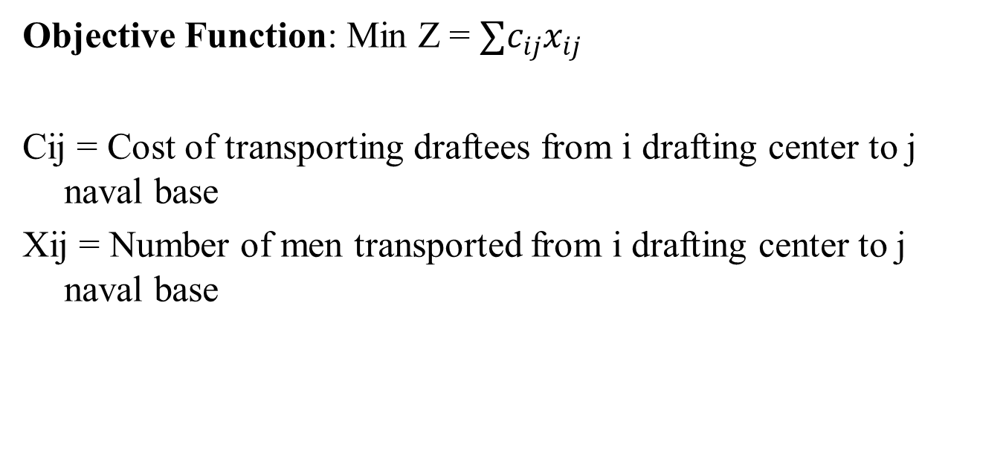
Mathematical Representation
Objective Function: Min Z = $∑c_{ij}x_{ij}$
Cij = Cost of transporting draftees from i drafting center to j naval base
Xij = Number of men transported from i drafting center to j naval base

Slide 8
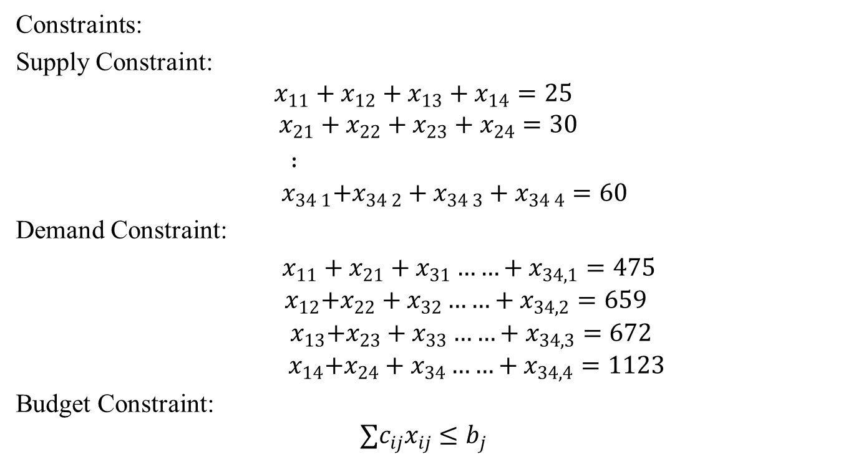
Mathematical Representation
Constraints:
Supply Constraint:
$$x_{11}+x_{12}+x_{13}+x_{14}=25$$
$$x_{21}+x_{22}+x_{23}+x_{24}=30$$
$:$
$${ x}_{34 1}+x_{34 2}+x_{34 3}+x_{34 4}=60$$
Demand Constraint:
$x_{11}+x_{21}+x_{31}……+x_{34,1}=475$
$${ x}_{12}+x_{22}+x_{32}……+x_{34,2}=659$$
$${ x}_{13}+x_{23}+x_{33}……+x_{34,3}=672$$
$${ x}_{14}+x_{24}+x_{34}……+x_{34,4}=1123$$
Budget Constraint:
$$∑c_{ij}x_{ij}≤b_{j}$$

Slide 9

Mathematical Representation
Where, $x_{ij}≥0$ and integer
i= number of drafting centers (1,2,3,4………………34)
j = number of naval bases(1,2,3,4)
$b_{j}$ = budget at each naval base j

Slide 10
Approach
Implemented Problem using the excel solver
We got minimum cost = $49,860
Sensitivity Analysis- The sensitivity analysis cannot be done because we have constraint for Xij should be integer.

Slide 11
Research Question:
Problem 2:
How should the draftees be transported by ship from branch naval bases to main base?
- We solved this problem by using Integer Programming model.
-computed the voyages table by using ships data and distance matrix .

Slide 12
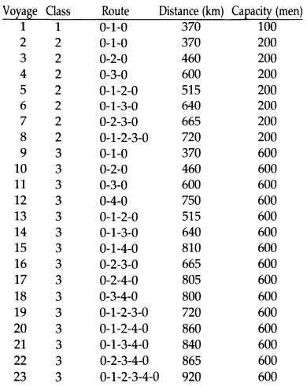
Ship information and voyages
Ship class | capacity | Available ships | Allowed bases
1 | 100 | 2 | 1
2 | 200 | 10 | 1,2,3
3 | 600 | 2 | 1,2,3,4

Slide 13
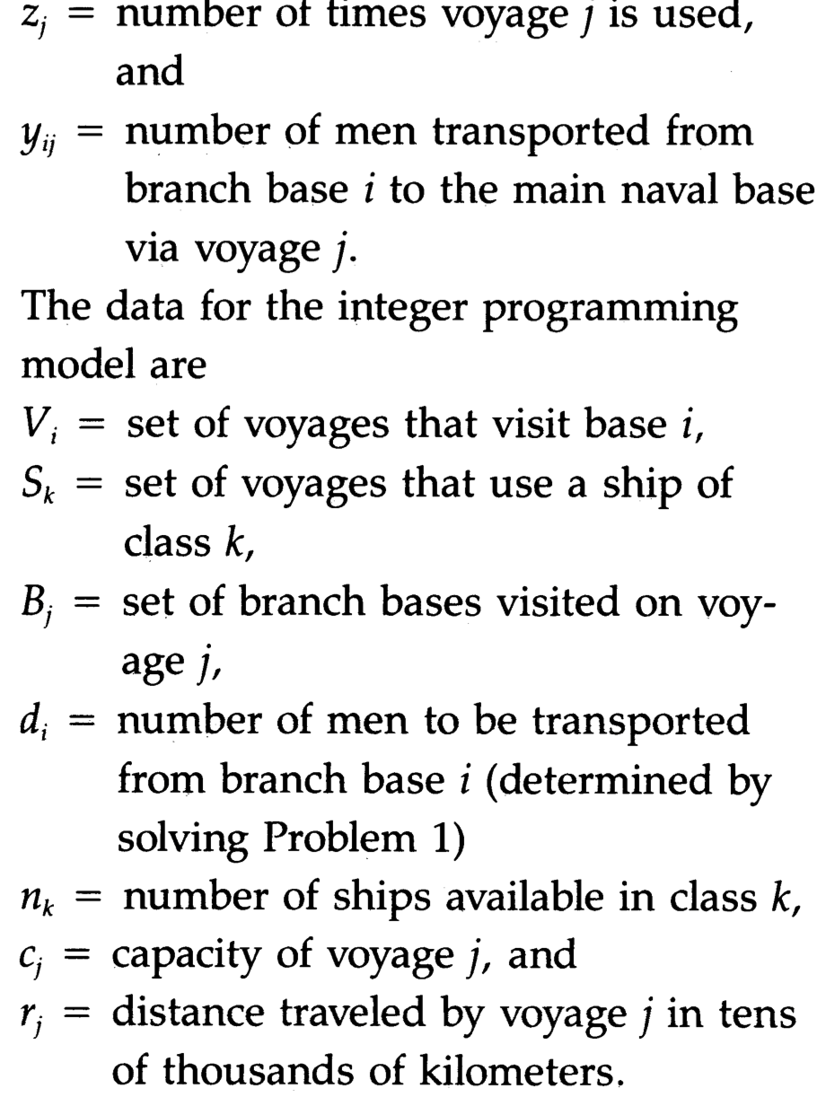
Variables for our model are

Slide 14
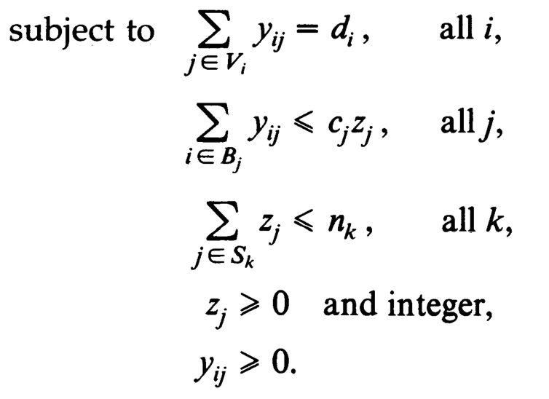

Objective function and constrains
For our objective is using min no of ships we need to transport every draftee and secondary goal is having min distance.
So, our objective function will be$\sum_{j}^{23}{{(z}_{j}+r_{j}}$ $z_{j})$.
And our constraints will be:

Slide 15
Approach
Implemented Problem using the excel solver
We get minimum distance = 10,605km
voyages | No of times it is used
2 | 2
5 | 4
8 | 3
15 | 1
23 | 1

Slide 16
Research Question:
Problem 2:
How should the draftees be transported by ship from naval bases to main base by using minimum distance and minimum ships from each
-we solved this problem by using minimal spanning tree algorithms from the given data and constraints in base paper about voyages and path from every class

Slide 17
Constraints in problem are:
n(k)= number of ships available in each class
n(1)= 2, n(2)= 3,n(3)=4
C(i)=capacity of ships in each class
C(1)=100 and it can only go to ‘1’ naval base
C(2)=200 and it can go to 1,2,3 naval bases
C(3)=600 and it can go to all the naval bases
N(a)=number of men available at naval bases
N(1)=475,N(2)=659,N(3)=672,N(4)=1123
Condition is that total number of men transported to main base should be exactly 2929
v(i)=set of voyages that visit main base from naval base where i=1,2,3,4,…..23
v(1)<=n(1),v(2)+…v(8)<=n(2),v(9)+……v(23)<=n(3)

Slide 18
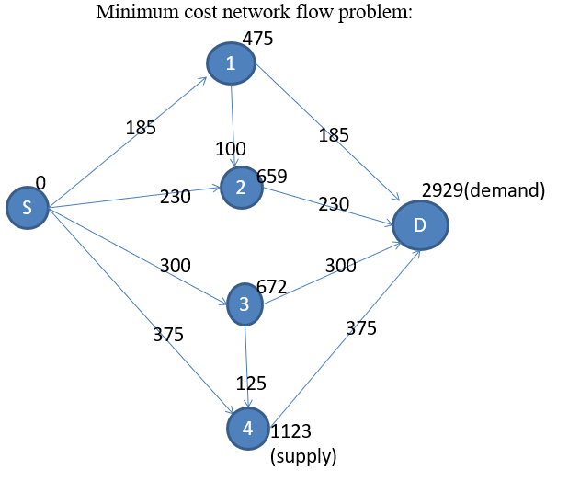
Shortest path with minimum no of ships and distance

Slide 19
Voyages we have used and their routes with minimum distance and minimum ships:
Voyage class route distance capacity
2 2 0-1-0 370 200
2 2 0-1-0 370 200
3 2 0-1-2-0 515 134(75+59)
10 3 0-2-0 460 600
11 3 0-3-0 600 595
12 3 0-4-0 750 600
18 3 0-3-4-0 800 600(523+77)
The minimum distance was 3865 km and minimum ships used was 7
(3 from class 2 and 4 from class 3)
The 2929 men were transported from naval bases 1,2,3,4 to main base (destination) used 7 voyages (2 nd voyage for 2 times and 3,10,11,12,18 are used)

Slide 20
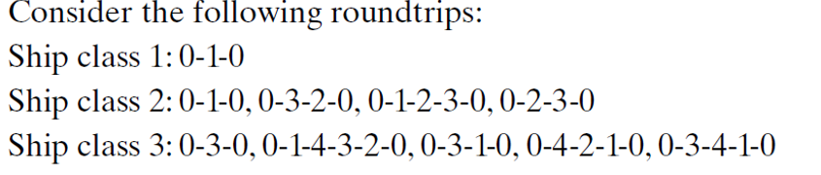
Bonus Research Problem
We also have other problem which has different distance matrix and voyage

Slide 21
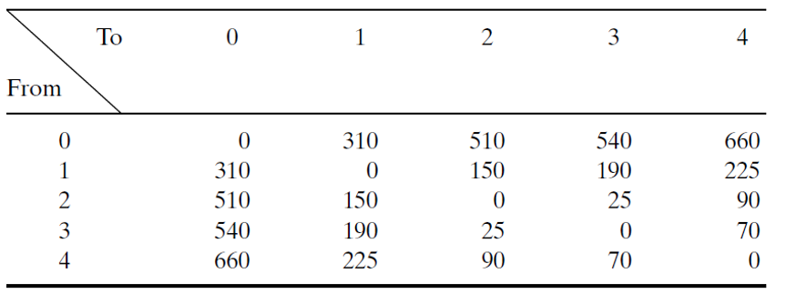
Distance Matrix for Main(0) and Branch Bases(1,2,3,4)

Slide 22
Constraints In the Problem
n(k)= number of ships available in each class
n(1)= 2, n(2)= 10,n(3)=4
C(i)=capacity of ships in each class
C(1)=100 and it can only go to ‘1’ naval base
C(2)=200 and it can go to 1,2,3 naval bases
C(3)=600 and it can go to all the naval bases
N(a)=number of men available at naval bases
N(1)=475,N(2)=659,N(3)=672,N(4)=1123
Condition is that total number of men transported to main base should be exactly 2929
v(i)=set of voyages that visit main base from naval base where i=1,2,3,4,…..23
v(1)<=n(1),v(2)+…v(5)<=n(2),v(6)+……v(10)<=n(3)

Slide 23
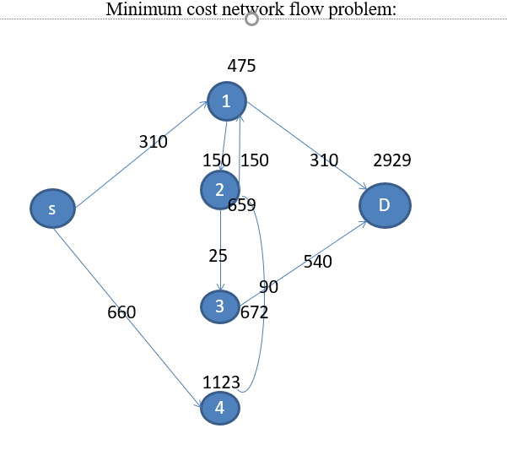
Shortest path with minimum no of ships and distance

Slide 24
Minimum distance and ships we used are:
Voyages Class Route Distance Capacity
2 2 0-1-0 620 200
2 2 0-1-0 620 200
4 2 0-1-2-3-0 1025 172
5 2 0-2-3-0 1075 200
5 2 0-2-3-0 1075 200
5 2 0-2-3-0 1075 200
5 2 0-2-3-0 1075 200
5 2 0-2-3-0 1075 200
5 2 0-2-3-0 1075 200
9 3 0-4-2-1-0 1210 578
9 3 0-4-2-1-0 1210 579
The minimum distance was 11,135 km and minimum ships used was 11
(9 from class 2 and 2 from class 3)
The 2929 men were transported from naval bases 1,2,3,4 to main base (destination) used 11 voyages (2 nd voyage for 2 times, 5 th voyage for 6 times , 9 th voyage for 2 times and 4 th voyage for one time )
Voyages Class Route Distance(km) Capacity
1 1 0-1-0 620 100
2 2 0-1-0 620 200
3 2 0-3-2-0 1075 200
4 2 0-1-2-3-0 1025 200
5 2 0-2-3-0 1075 200
6 3 0-3-0 1080 600
7 3 0-1-4-3-2-0 1140 600
8 3 0-3-1-0 940 600
9 3 0-4-2-1-0 1210 600
10 3 0-3-4-1-0 1580 600

Slide 25
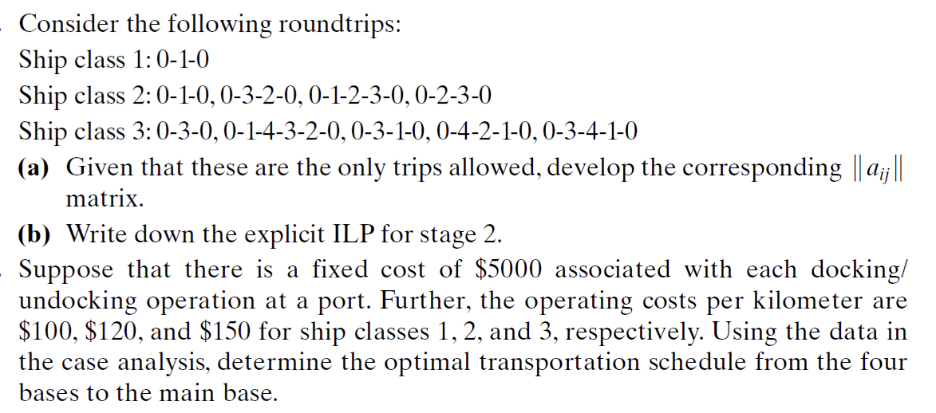

Slide 26

Solution for b part
Here our objective will be
Minimum cost
Objective function:
min f=5000*$\sum_{j}{z_{j}}$+62000*z1+74400*z2+
Z3*148800+z4*123000+z5*129000+
z6*162000+z7*171000+z8*156000+
Z9*181500+z10*171750
and our constraints are:
Voyages Class Route Distance(km) Capacity
1 1 0-1-0 620 100
2 2 0-1-0 620 200
3 2 0-3-2-0 1075 200
4 2 0-1-2-3-0 1025 200
5 2 0-2-3-0 1075 200
6 3 0-3-0 1080 600
7 3 0-1-4-3-2-0 1140 600
8 3 0-3-1-0 940 600
9 3 0-4-2-1-0 1210 600
10 3 0-3-4-1-0 1580 600

Slide 27
solution
Implemented Problem using the excel solver
We get minimum cost as = 140,6800
voyage | No of times a voyage is used
2 | 2
4 | 7
7 | 2

Slide 28
Conclusion
-For the problems Excel solver gives us results faster as compared to manually solving problems.
-Complex computations are done efficiently which are not possible manually.

Slide 29
Future Work
-Shortest Path algorithm can be implemented in future to get the best results.
-Due to time constraints we were not able to implement the Shortest Path Algorithm.

Slide 30
Thank You !!!!!

